Slide 1
Module-3: Unsupervised Learning:
Clustering: K-Means clustering, Hierarchical clustering, Evaluation of clustering results.
Dimensionality Reduction: Principal Component Analysis (PCA), Linear Discriminant Analysis (LDA) t-Distributed Stochastic Neighbor Embedding (t-SNE).
Association Rule Learning: Apriori algorithm, Market Basket Analysis, Evaluation metrics for association rules

Slide 2
Unsupervised Learning:
Unsupervised Machine learning is a type of machine learning where the algorithm is trained on unlabeled data, and the objective is to find patterns, relationships, or structures within the data without explicit guidance or labeled outcomes. i.e Unsupervised learning is a method we use to group data when no labels are present.
As the name suggests, unsupervised learning is a machine learning technique in which models are not supervised using training dataset. Instead, models itself find the hidden patterns and insights from the given data. It can be compared to learning which takes place in the human brain while learning new things.
It can be defined as: “Unsupervised learning is a type of machine learning in which models are trained using unlabeled dataset and are allowed to act on that data without any supervision.”
Unsupervised learning cannot be directly applied to a regression or classification problem because unlike supervised learning, we have the input data but no corresponding output data.

Slide 3
Example: Suppose the unsupervised learning algorithm is given an input dataset containing images of different types of cats and dogs. The algorithm is never trained upon the given dataset, which means it does not have any idea about the features of the dataset. The task of the unsupervised learning algorithm is to identify the image features on their own. Unsupervised learning algorithm will perform this task by clustering the image dataset into the groups according to similarities between images.
Note: Unsupervised machine learning (ML) works differently from supervised ML because it doesn't rely on labeled data to learn patterns or make predictions. Instead, unsupervised ML algorithms focus on finding hidden structure or patterns within the data without explicit guidance from predefined labels.

Slide 4
Why use Unsupervised Learning?
Unsupervised learning is helpful for finding useful insights from the data.
Unsupervised learning is much similar as a human learns to think by their own experiences, which makes it closer to the real AI.
Unsupervised learning works on unlabeled and uncategorized data which make unsupervised learning more important.
In real-world, we do not always have input data with the corresponding output so to solve such cases, we need unsupervised learning.
Semi-supervised Learning: Unsupervised ML techniques can also be combined with supervised ML in semi-supervised learning approaches. In this paradigm, a small amount of labeled data is augmented with a larger amount of unlabeled data to improve the performance of supervised models.

Slide 5
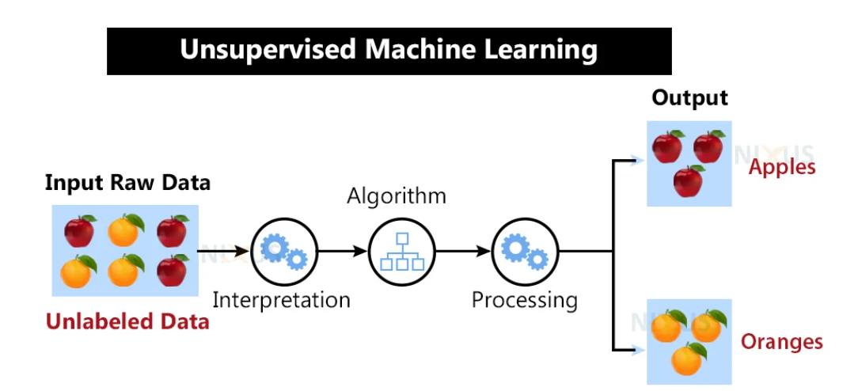

Slide 6
Here, we have taken an unlabeled input data, which means it is not categorized, and corresponding outputs are also not given. Now, this unlabeled input data is fed to the machine learning model in order to train it. Firstly, it will interpret the raw data to find the hidden patterns from the data and then will apply suitable algorithms such as k-means clustering, Decision tree, etc. Once it applies the suitable algorithm, the algorithm divides the data objects into groups according to the similarities and dissimilarities between the objects.
Working of Unsupervised learning models:
We feed the model data with no categories or outputs for training
Model interprets raw data to identify hidden patterns
Depending on data, we use suitable algorithms
Algorithm groups data

Slide 7
Disadvantages of Unsupervised Learning:
1. Unsupervised learning is fundamentally more difficult than supervised learning since it lacks comparable results.
2. The outcome of an unsupervised learning approach may be less accurate since the input data does not have labels and algorithms do not know the precise output in advance.
3. We need humans to validate the results of unsupervised learning models which convolutes the process.
4. The operations involved require a high level of computational power and also take up a lot of time.
Alternative to Unsupervised Learning:
Semi-supervised learning may be a viable alternative to unsupervised learning. It is a combination or even a min-and-match of both unsupervised and supervised learning methods. The primary benefit of this sort of training would be that it lowers errors.
For example, it will only cluster the unlabeled data that fits the clustering criteria, and it will categorize the output automatically once it has labels. This uses less computer power and takes less time.

Slide 8
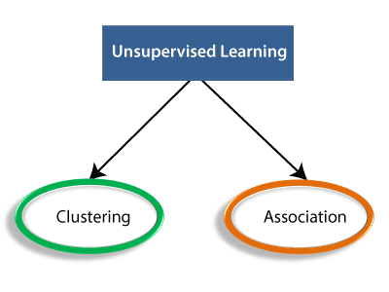
Types of Unsupervised Learning:
1. Clustering
2. Association rules
3. Dimensionality reduction.

Slide 9
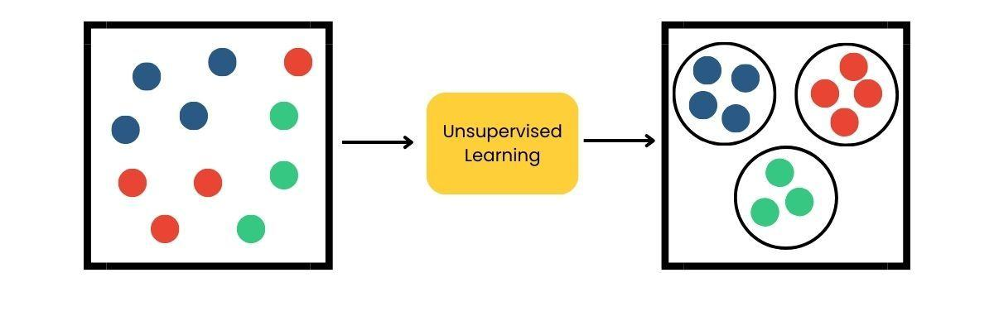
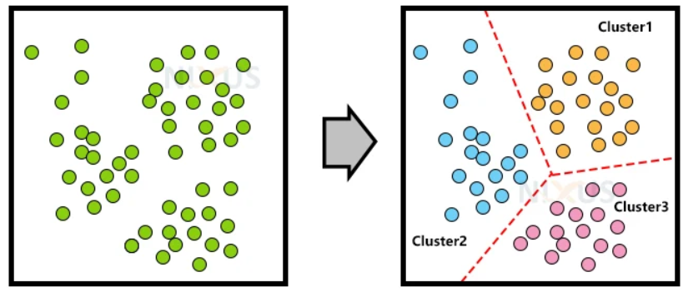
Clustering:
Clustering methods involve grouping untagged data based on their similarities and differences. When two instances appear in different groups, we can infer they have dissimilar properties.
Clustering is a type of unsupervised learning, meaning that we do not need labeled data for clustering algorithms; this is one of the biggest advantages of clustering over other supervised learning like Classification.
Clustering is the process of arranging a group of objects in such a manner that the objects in the same group (which is referred to as a cluster) are more similar to each other than to the objects in any other group.
OR

Slide 10
Different Types of Clustering Techniques
The major clustering techniques are
Partitioning methods
K-Means
kmedoid.
Hierarchical methods
Agglomerative Hierarchical Clustering
Divisive Hierarchical Clustering
Density-based methods
DBSCAN

Slide 11
Partitioning Methods:
Partitioning methods aim to divide the data points into distinct non-overlapping subgroups or clusters. Each data point belongs to exactly one cluster.
Two of the most important algorithms for partitioning-based clustering are:
k-means (A centroid-based technique)
kmedoid
In the k-means algorithm, the centroid of the prototype is identified for clustering, which is normally the mean of a group of points. Similarly, the k-medoid algorithm identifies the medoid which is the most representative point for a group of points. We can also infer that in most cases, the centroid does not correspond to an actual data point, whereas medoid is always an actual data point.

Slide 12
K-Means Clustering:
K-Means is an unsupervised learning algorithm used to group similar data points into K clusters. Each cluster has a centroid (center point), and each data point belongs to the cluster with the nearest mean or centroid.
The goal of clustering is to divide the population or set of data points into a number of groups so that the data points within each group are more comparable to one another and different from the data points within the other groups. It is essentially a grouping of things based on how similar and different they are to one another.
The principle of the k-means algorithm is to assign each of the ‘n’ data points to one of the K clusters where ‘K’ is a user-defined parameter as the number of clusters desired. The objective is to maximize the Homogeneity within the clusters and also to maximize the differences between the clusters. The homogeneity and differences are measured in terms of the distance between the objects or points in the data set.

Slide 13
What the “Means” indicates in the Name K-Means:
In the context of the k-Means algorithm, "Means" refers to the centroids of the clusters.
The word "Means" comes from the fact that in the k-Means algorithm, each cluster is represented by the mean or average of all the data points assigned to that cluster. These means are also called centroids.
During each iteration of the algorithm, the centroids are recalculated to update their positions based on the current assignment of data points to clusters. The centroids are computed as the average of the data points belonging to each cluster.
For example, suppose you have a cluster of two-dimensional points with the following coordinates:
(1, 3), (2, 4), (3, 5)
To find the centroid of this cluster, you would calculate the mean of the x-coordinates and the mean of the y-coordinates separately:
Mean x-coordinate = (1 + 2 + 3) / 3 = 2
Mean y-coordinate = (3 + 4 + 5) / 3 = 4
So, the centroid of this cluster would be the point (2, 4). This point represents the "mean" or "average" location of the data points in that cluster.

Slide 14
Simple algorithm of K-means:
Step 1:
Choose the number of clusters, 'k', that you want to identify.
Randomly initialize 'k' cluster centroids.
Loop
Step 2: Assign each point in the data space to the nearest centroid to form K clusters
Step 3: Measure the distance of each point in the cluster from the centroid
Step 4: Calculate the Sum of Squared Error (SSE) to measure the quality of the clusters.
This is to measure whether the K value is good or bad.
Step 5: Identify the new centroid of each cluster on the basis of distance between points Step 6: Repeat Steps 2 to 5 to refine until centroids do not change.
End Loop.

Slide 15
🔷 Real-Life Example:
Let’s say you own a shopping mall, and you want to understand customer segments based on:
Age
Spending Score (1–100)
You have no labels like “Student”, “Worker”, etc., but you want to group similar customers together — that's where K-Means helps.

Slide 16
🔷 Step-by-Step K-Means Algorithm:
Let’s assume we want to divide the customers into K = 2 clusters.
Step 1: Choose the number of clusters K
Let’s choose K = 2 for now.
Step 2: Initialize Centroids
Randomly pick 2 points as initial centroids (cluster centers).
Step 3: Assign Each Data Point to the Closest Centroid
For each customer (data point), calculate the distance (typically Euclidean distance) to each centroid.
Assign it to the cluster of the nearest centroid.
Step 4: Update Centroids
For each cluster, calculate the mean of all points in the cluster.
This becomes the new centroid.
Step 5: Repeat
Repeat Steps 3 and 4 until:
Centroids do not change significantly (convergence)
OR after a fixed number of iterations

Slide 17
Problem Statement:
Customer ID | Age | Spending Score
1 | 25 | 80
2 | 34 | 65
3 | 40 | 20
4 | 22 | 85
5 | 49 | 10

Slide 18
Solution: Apply K-Means Algorithm
Let’s assume K = 2.
Initial centroids:
Centroid A: (25, 80)
Centroid B: (40, 20)
Assign points to the closest centroid:
Points 1, 2, 4 closer to Centroid A (Cluster 1)
Points 3, 5 closer to Centroid B (Cluster 2)
Recalculate centroids:
Cluster 1 mean = avg of (25, 80), (34, 65), (22, 85)
Cluster 2 mean = avg of (40, 20), (49, 10)
Repeat this process until centroids don’t change.

Slide 19
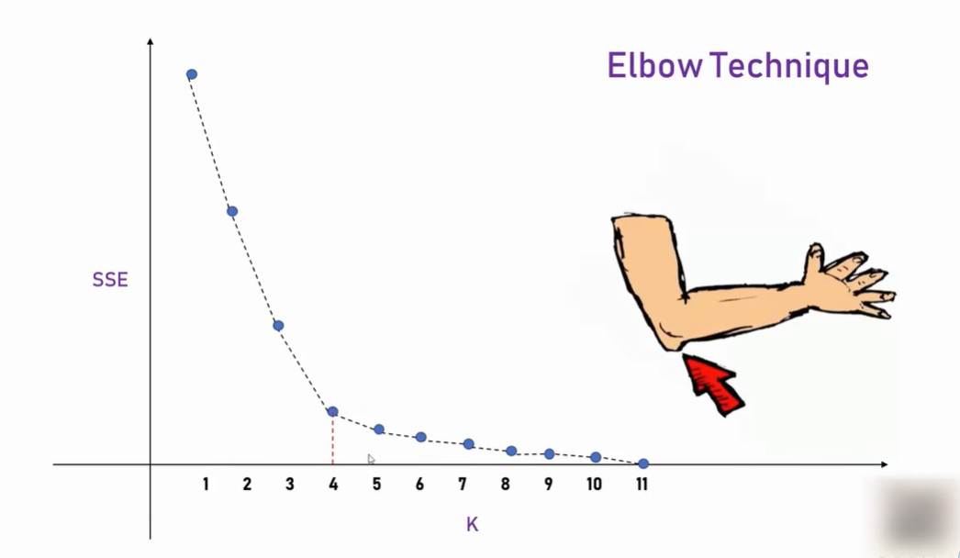
🔷 How to Choose K?
Use the Elbow Method:
Run K-means for different values of K (e.g., 1 to 10)
Plot Within-Cluster Sum of Squares (WCSS)
The "elbow point" is where the decrease slows down

Slide 20
🔷 Applications of K-Means
Customer Segmentation
Document or News Clustering
Image Compression
Market Basket Analysis

Slide 21
2. Hierarchical clustering:
Hierarchical clustering is a clustering technique used in unsupervised machine learning to group similar data points into clusters that form a hierarchy. Unlike k-Means, which requires the number of clusters to be specified beforehand, hierarchical clustering does not require the number of clusters to be predefined. Instead, it organizes the data points into a tree-like structure, called a dendrogram, based on their similarities.
The hierarchical clustering methods are used to group the data into hierarchy or tree-like structure.
For example, in a machine learning problem of organizing employees of a university in different departments, first the employees are grouped under the different departments in the university, and then within each department, the employees can be grouped according to their roles such as professors, assistant professors, supervisors, lab assistants, etc. This creates a hierarchical structure of the employee data and eases visualization and analysis. Similarly, there may be a data set which has an underlying hierarchy structure that we want to discover and we can use the hierarchical clustering methods to achieve that.

Slide 22
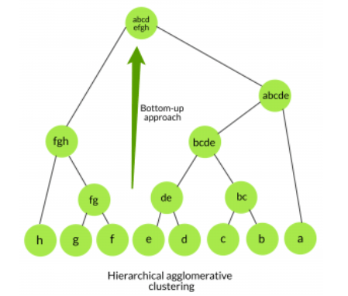
There are two main approaches to hierarchical clustering:
Agglomerative Hierarchical Clustering
Divisive Hierarchical Clustering
Agglomerative Hierarchical Clustering: (Bottom-Up)
The agglomerative hierarchical clustering method uses the bottom-up strategy. It starts with each object forming its own cluster and then iteratively merges the clusters according to their similarity to form larger clusters. It terminates either when a certain clustering condition imposed by the user is achieved or all the clusters merge into a single cluster.
This approach starts by considering each data point as a single-cluster. Then, at each step, it merges the two closest clusters until all data points belong to a single cluster or until a stopping criterion is met. The result is a dendrogram that shows the merging process and allows us to identify clusters at different levels of granularity.

Slide 23
Step-by-Step: Agglomerative Hierarchical Clustering
Step 1: Treat each point as its own cluster
A, B, C, D, E → 5 separate clusters
Step 2: Calculate distances between all clusters
Use a distance metric (usually Euclidean distance)
Step 3: Merge the closest clusters
Merge the pair with the least distance
Step 4: Recalculate distances between the new cluster and all other clusters
Depends on linkage method (next slide)
Step 5: Repeat Steps 3–4 until only one cluster remains

Slide 24
🔷 Linkage Methods (How to measure distance between clusters):
Linkage Type | Description
Single | Distance between the closest points of two clusters
Complete | Distance between the farthest points
Average | Average distance between all points of the two clusters
Ward | Minimize variance between clusters (default in scikit-learn)

Slide 25
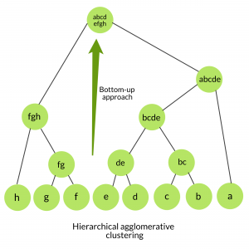
Dendrogram: The Tree of Clusters 🌳
A dendrogram is a diagram showing how clusters were merged or split at each step.
The height of the branches shows the distance (dissimilarity) between clusters.
You can cut the dendrogram at a certain height to choose the number of clusters.

Slide 26

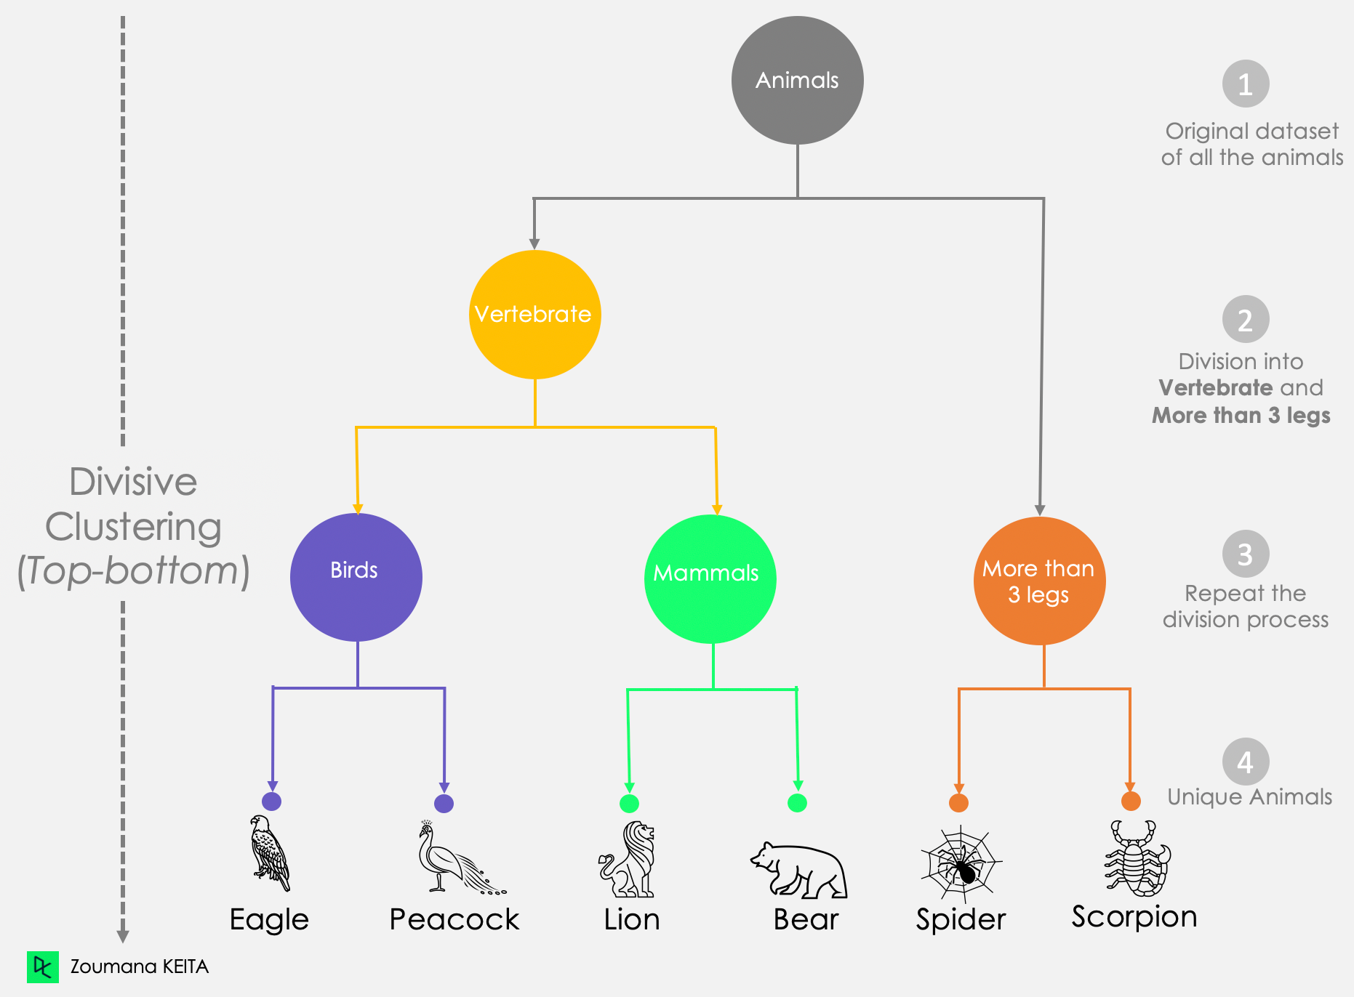
2. Divisive Hierarchical Clustering: (Top-Down)
The divisive hierarchical clustering method uses a top-down strategy. The starting point is the largest cluster with all the objects in it, and then, it is split recursively to form smaller and smaller clusters, thus forming the hierarchy. The end of iterations is achieved when the objects in the final clusters are sufficiently homogeneous to each other or the final clusters contain only one object or the user-defined clustering condition is achieved.

Slide 27
What is Divisive Hierarchical Clustering?
Divisive Clustering is a top-down approach:
Start with all data points in one big cluster
Recursively split the cluster into smaller sub-clusters
Continue until each point is in its own cluster
📌 It’s the reverse of Agglomerative Clustering, which builds clusters bottom-up.
Real-Life Analogy
Imagine you’re organizing a conference with 100 participants.
You start by putting everyone in one big room.
Then you:
Split them based on role (e.g., Speaker vs. Attendee)
Split Attendees by experience level (Beginner vs. Advanced)
Further divide based on topics of interest (e.g., AI, Web Dev)
This recursive splitting continues until you form meaningful subgroups.

Slide 28
Divisive Clustering: Step-by-Step
Let’s say you have 5 animals, each described by their features (like weight and speed):
Animal | Speed | Weight
Tiger | 80 | 200
Lion | 75 | 190
Deer | 60 | 90
Rabbit | 45 | 30
Turtle | 5 | 50

Slide 29
Solution:
Step 1: Start with all data in one cluster
Cluster: [Tiger, Lion, Deer, Rabbit, Turtle]
Step 2: Split the cluster into 2 sub-clusters
Use a clustering algorithm (like K-Means) to divide the cluster into 2 groups:
Cluster A: [Tiger, Lion]
Cluster B: [Deer, Rabbit, Turtle]
Step 3: Recursively apply Step 2 on each sub-cluster
Now split Cluster B further:
Cluster B1: [Deer]
Cluster B2: [Rabbit, Turtle]
Then split B2:
[Rabbit] and [Turtle]
Keep doing this until all animals are in individual clusters or you reach a stopping criterion.

Slide 30
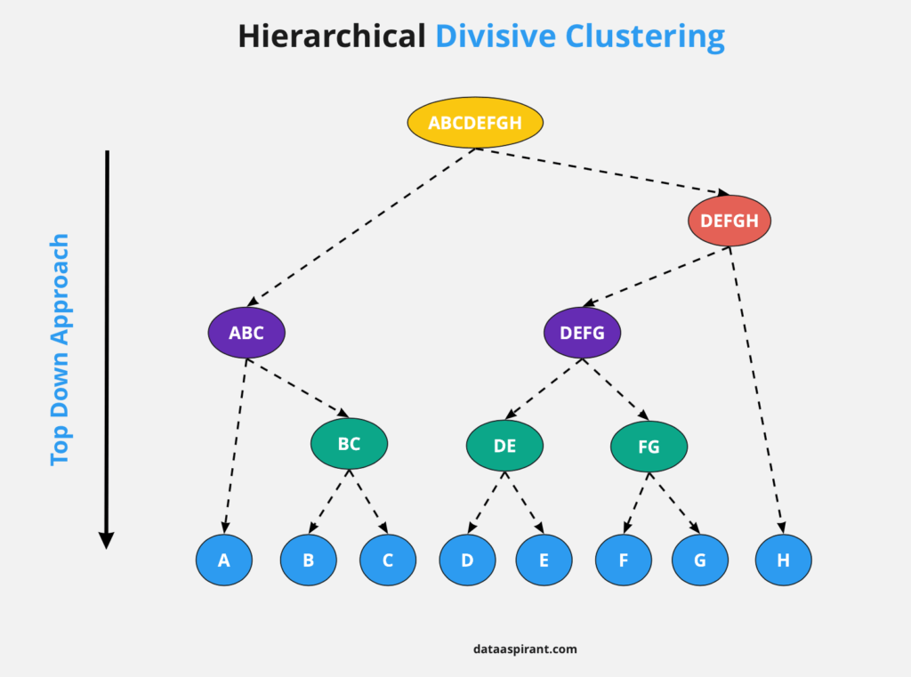
Dendrogram: The Tree of Clusters 🌳
A dendrogram is a diagram showing how clusters were merged or split at each step.
The height of the branches shows the distance (dissimilarity) between clusters.
You can cut the dendrogram at a certain height to choose the number of clusters.

Slide 31
Evaluation of Clustering Results:
Once you perform clustering, the next big question is:
How do I know if the clustering is good or meaningful?
Since clustering is unsupervised (no true labels), we need special evaluation metrics.
There are two main types of evaluation methods:
1. Internal Evaluation
Measures the quality of clustering using the data itself (without external labels).
2. External Evaluation
Compares the clustering result to ground truth labels (actual, correct labels or categories of the data, if available).

Slide 32
1. Internal Evaluation Metrics (most common)
Metric Name | Meaning
Silhouette Score | Measures how well a point fits into its cluster vs. others. Higher is better (range -1 to +1).
Inertia (Within-cluster SSE) | Sum of squared distances between points and their cluster centroid. Lower is better.
Davies–Bouldin Index | Ratio of intra-cluster to inter-cluster distance. Lower is better.
Dunn Index | Ratio of the smallest distance between clusters to the largest diameter of a cluster. Higher is better.

Slide 33
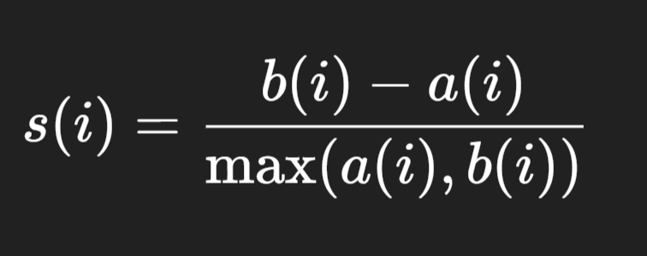
Silhouette Score:
The Silhouette Score is a metric used to evaluate the quality of a clustering result. It measures how well each data point fits within its cluster compared to other clusters.
Definition
For a data point i:
a(i) = average distance between i and all other points in the same cluster
b(i) = lowest average distance between i and points in any other cluster (i.e., the nearest cluster)
The silhouette score s(i) for a single point is calculated as:

Slide 34
Score Range & Interpretation
+1 → Perfectly clustered (well matched to its own cluster, far from others)
0 → On or very close to the boundary between clusters
-1 → Probably in the wrong cluster
Example (Intuitive)
Imagine you’re organizing books in a library:
If a book is grouped with very similar books and very different from books in other shelves → high silhouette score.
If a book is equally similar to books in multiple shelves → score around 0.
If a book is more similar to books in another shelf than its own → negative score.

Slide 35
Example: Simple 2D Data
Assume we have 6 data points clustered into 2 clusters:
Cluster A: A1(1,2), A2(2,1), A3(1,0)
Cluster B: B1(8,8), B2(9,10), B3(10,9)
Let’s compute the silhouette score for point A1(1,2).

Slide 36
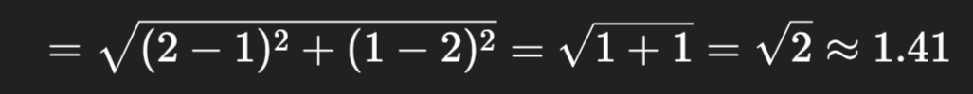
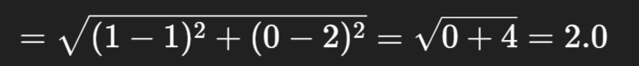
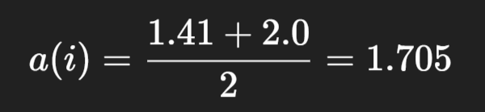
Step 1: Compute a(i) – average distance to points in the same cluster
A1 is in Cluster A, so we compute distances to A2 and A3:
Distance A1 to A2:
Distance A1 to A3:

Slide 37
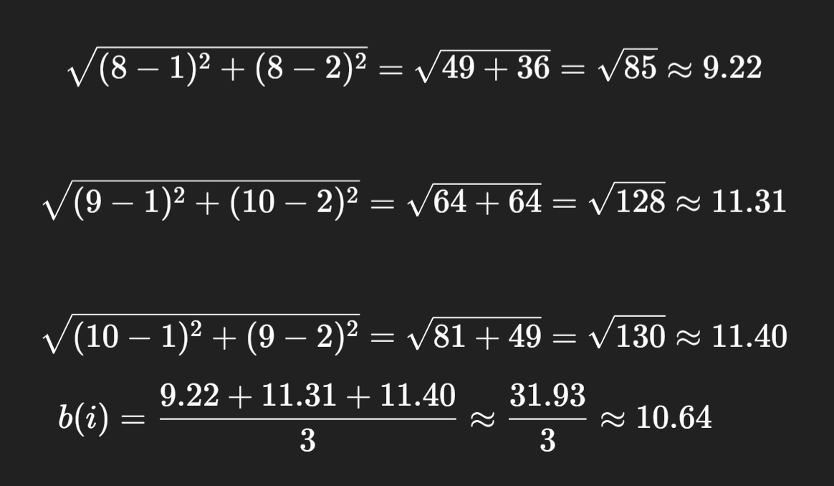
Step 2: Compute b(i) – average distance to the nearest other cluster
A1 is in Cluster A. The nearest other cluster is Cluster B. So compute average distance from A1 to all points in Cluster B:
A1 to B1(8,8):
A1 to B2(9,10):
A1 to B3(10,9):

Slide 38
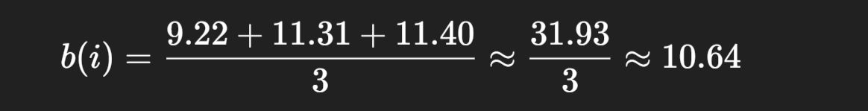
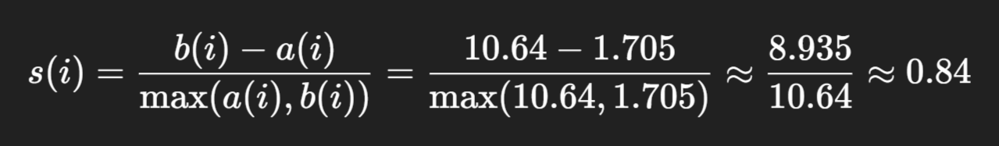
Step 3: Apply the Silhouette Formula

Slide 39
✅ Final Result:
The silhouette score for point A1 is 0.84, which means:
It is well-clustered (far from the other cluster).
The clustering algorithm did a great job placing this point.
To get the final performance (overall silhouette score) of your clustering result, you need to:
Repeat the following for every data point:
Compute a(i) – average distance to all other points in the same cluster.
Compute b(i) – average distance to all points in the nearest other cluster.
Apply the silhouette formula

Slide 40
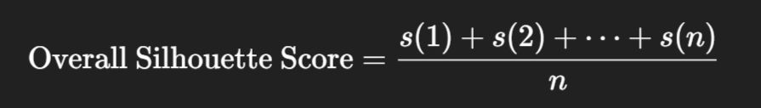
Then: Average all the individual scores
Once you compute s(i) for all points, take the average:

Slide 41
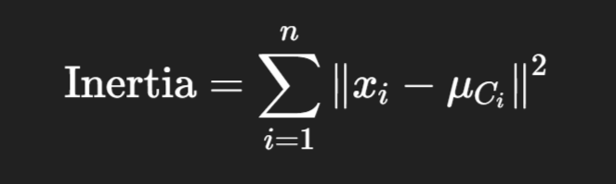
2. Inertia (SSE – Sum of Squared Errors):
Inertia (SSE) measures how compact the clusters are. It is the sum of squared distances between each point and the centroid of its assigned cluster.
Formula for Inertia (SSE):
Where:
𝑥𝑖 = data point
μCi = centroid of the cluster that
∥⋅∥² = squared Euclidean distance

Slide 42
Interpretation:
Lower Inertia = tighter, more compact clusters → good clustering.
Higher Inertia = points are spread out from their centroids → poor clustering.
But too low inertia may mean overfitting with too many small clusters.

Slide 43
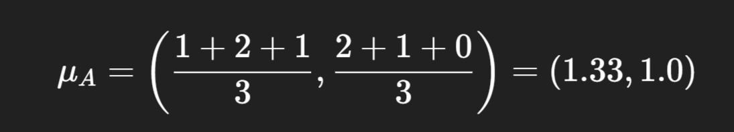
Example: Same as Before
Let’s reuse the same 6 points and compute Inertia for them.
➕ Cluster A: A1(1,2), A2(2,1), A3(1,0)
Step-1: First, compute the centroid of Cluster A:
Now calculate squared distances from each point to the centroid:

Slide 44
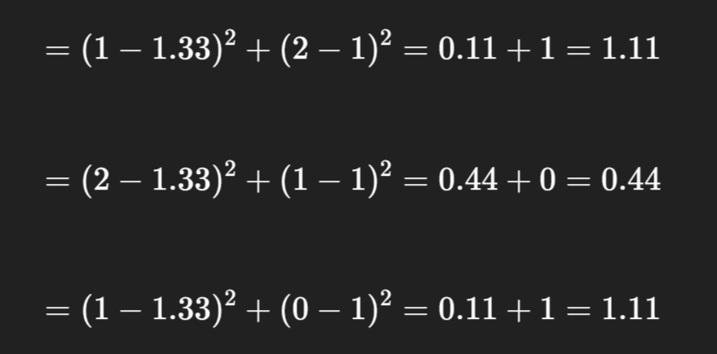
A1 to centroid:
A2 to centroid:
A3 to centroid:
👉 SSE for Cluster A = 1.11 + 0.44 + 1.11 = 2.66

Slide 45
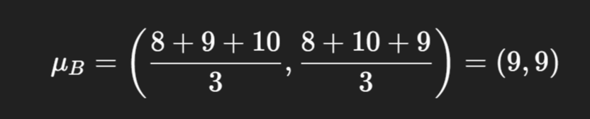
➕ Cluster B: B1(8,8), B2(9,10), B3(10,9)
Centroid of Cluster B:
Now calculate squared distances from each point to the centroid for Cluster B

Slide 46
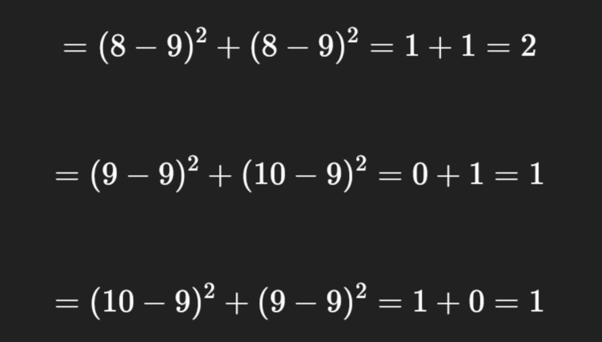
B1 to centroid:
B2 to centroid:
B3 to centroid:
👉 SSE for Cluster B = 2 + 1 + 1 = 4

Slide 47
Total Inertia (SSE) = 2.66 + 4 = 6.66
Conclusion:
AMetric | Value | Meaning
Inertia (SSE) | 6.66 | How compact all clusters are
Lower is better | ✔ | But don’t make too many clusters

Slide 48
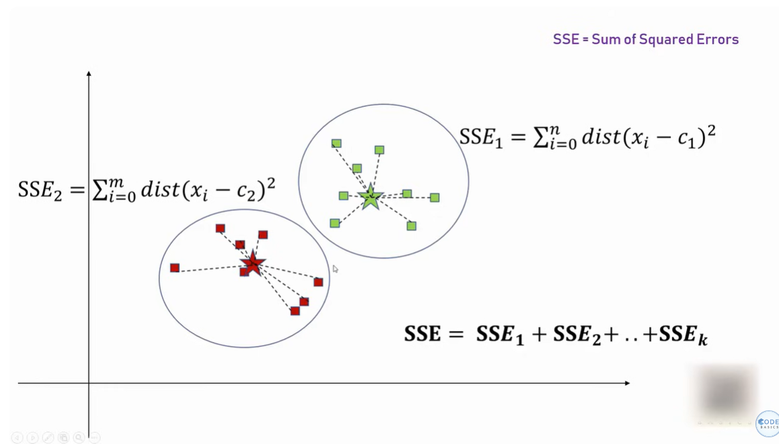
How to Determine Correct Number of Clusters (K): (Elbow Method)
Find Sum of Squared Errors (SSE) for Each Cluster in Each Iteration.
Which means For each of the cluster you try to compute the distance of individual data point from the centroid and then square it and sum it up. Do the same for all of the clusters you have and at the end you will get the following: SSE1 + SSE2 + ………… + SSEk

Slide 49
Once we get SSE for all the Clusters then we will plot a graph as below to find the Elbow which indicates the best number of cluster to consider or take initially.

Slide 50
2. External Evaluation Metrics (if true labels are known)
Metric Name | Meaning
Adjusted Rand Index (ARI) | Measures similarity between clustering and true labels.
Normalized Mutual Information (NMI) | Measures mutual dependence between clusters and labels.
Fowlkes–Mallows Index (FMI) | Geometric mean of precision and recall.

Slide 51
1. Adjusted Rand Index (ARI):
ARI is used to evaluate clustering performance when you already know the true group labels (called “ground truth”).
It checks how many pairs of points are:
correctly clustered together
correctly clustered apart
and adjusts for chance grouping
ARI range:
+1 = Perfect clustering
0 = Random clustering
< 0 = Worse than random (bad)

Slide 52
🔍 Example:
Let’s take 4 students: A, B, C, D
True groups (Actual Known Groups or labels):
Group 1: A, B
Group 2: C, D
Clustered result (Algorithm/Model Output):
Cluster 1: A, C
Cluster 2: B, D
👉 Goal: Compare Clustered Result with True Labels using ARI!

Slide 53
All possible 2 student pairs:
Total pairs = 6
^{Pair} | Same Group in True Group (Actual Known Groups )? | Same Clustered Group(Algorithm/Model Output)?
^{A-B} | ^{✅ Yes} | ^{❌ No}
^{A-C} | ^{❌ No} | ^{✅ Yes}
^{A-D} | ^{❌ No} | ^{❌ No}
^{B-C} | ^{❌ No} | ^{❌ No}
^{B-D} | ^{❌ No} | ^{✅ Yes}
^{C-D} | ^{✅ Yes} | ^{❌ No}

Slide 54
Count the pairs:
✅ SS = Same in both → 0 pairs
✅ DD = Different in both → 2 pairs (A-D, B-C)
❌ SD / DS = Mismatches → 4 pairs
So, only 2 out of 6 pairs match the real grouping.

Slide 55
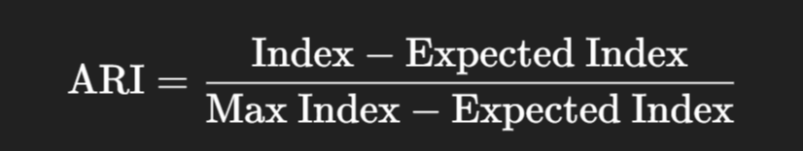
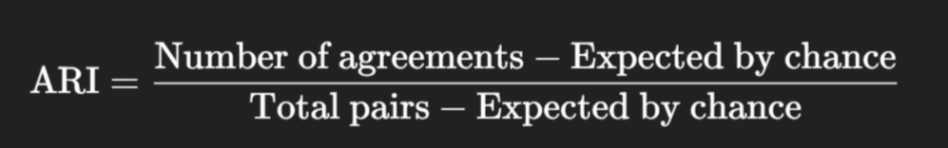
Apply ARI Formula (Simplified)
The ARI formula is:
In basic cases, you can think of it as:

Slide 56
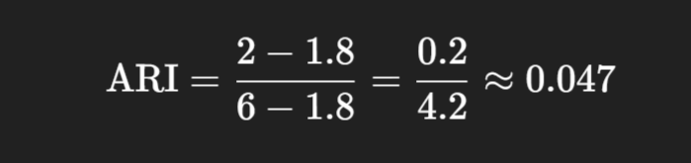
Let’s say:
Agreements = 2 (The clustering algorithm and the true labels both agreed that the pair was either in the same group, or in different groups)
Expected = 1.8 (the number of agreements we’d expect by random chance it’s close to the 2 actual agreements we got)
Total pairs = 6
Then:
Final Interpretation:
ARI ≈ 0.047 → Very close to 0
This means the clustering is almost random ❌
If ARI was near 1, it would be perfect

Slide 57
Dimensionality Reduction:
Dimensionality reduction transforms a high‑dimensional dataset X∈Rn×d into a new representation Z∈Rn×k where k≪d, while preserving as much of the “essential structure” as possible. Because no target labels are required, it is classed as an unsupervised learning task.

Slide 58
2. Dimensionality Reduction:
Dimensionality reduction is a technique used in unsupervised machine learning to reduce the number of input features or variables in a dataset while preserving as much of its essential information.
In other words, it is a process of transforming high-dimensional data into a lower-dimensional space that still preserves the essence of the original data.
The primary goal is to overcome the curse of dimensionality, improve computational efficiency, and sometimes enhance the interpretability of the data.
Two common methods for dimensionality reduction are
Principal Component Analysis (PCA) and
t-Distributed Stochastic Neighbor Embedding (t-SNE).

Slide 59
Curse of dimensionality:
In machine learning, high-dimensional data refers to data with a large number of features or variables. The curse of dimensionality is a common problem in machine learning, where the performance of the model deteriorates or drops as the number of features increases.
This is because the complexity of the model increases with the number of features, and it becomes more difficult to find a good solution. In addition, high-dimensional data can also lead to overfitting, where the model fits the training data too closely and does not generalize well to new data.
It’s helpful to reduce the dimensionality of a dataset during EDA (Exploratory Data Analysis) to help visualize data: this is because visualizing data in more than three dimensions is difficult. From a data processing perspective, reducing the dimensionality of the data simplifies the modeling problem.
When more input features are being fed into the model, the model must learn a more complex approximation function. This phenomenon can be summed up by a saying called the “curse of dimensionality.”
Dimensionality reduction can help to mitigate these problems by reducing the complexity of the model and improving its generalization performance. There are two main approaches to dimensionality reduction: feature selection and feature extraction.

Slide 60
Feature Engineering:
Feature Selection:
Feature selection involves selecting a subset of the original features that are most relevant to the problem at hand. The goal is to reduce the dimensionality of the dataset while retaining the most important features.
There are several methods for feature selection, including
Filter methods
Wrapper methods
Embedded methods
Filter methods rank the features based on their relevance to the target variable, wrapper methods use the model performance as the criteria for selecting features, and embedded methods combine feature selection with the model training process.

Slide 61
2. Feature Extraction:
Feature extraction involves creating new features by combining or transforming the original features. The goal is to create a set of features that captures the essence of the original data in a lower-dimensional space. There are several methods for feature extraction, including:
principal component analysis (PCA)
linear discriminant analysis (LDA)
t-distributed stochastic neighbor embedding (t-SNE).
PCA is a popular technique that projects the original features onto a lower-dimensional space while preserving as much of the variance as possible.

Slide 62
Principal Component Analysis (PCA):
Principal Component Analysis (PCA) is a technique used to reduce the number of features (columns) in your data without losing too much important information.
It does this by:
Finding the directions (called components) in which the data varies the most
Rotating the data to align with these directions
Dropping the less important directions
Think of it like summarizing a long paragraph in fewer sentences, but keeping the main message.

Slide 63
📌 Why use PCA?
To simplify data for faster processing
To visualize high-dimensional data in 2D or 3D
To remove noise or less useful features
To help cluster or classify data better

Slide 64
🪄 Simple Real-Life Example
Let’s say you have a dataset of students with:
Observation:
Math and Physics marks are very similar – they go up and down together. That means the second subject doesn’t add much new info.
So instead of using 2 features, PCA can reduce this to 1 feature: the combined score trend.
Student | Math Marks | Physics Marks
A | 80 | 82
B | 85 | 87
C | 78 | 79
D | 92 | 94
E | 70 | 72

Slide 65
Steps in PCA
Standardize the data
So that all features have same scale (mean = 0, std = 1)
Find the directions of maximum variance
These are called principal components
First component (PC1): captures the most variation
Second component (PC2): captures the next most, and so on
Project data onto new axes
This gives us a compressed version of the data

Slide 66
2. Linear Discriminant Analysis (LDA):
Linear Discriminant Analysis (LDA) is a supervised machine learning technique used for:
Dimensionality reduction
Classification
Unlike PCA, which is unsupervised, LDA uses the class labels to find the best features that separate the classes.

Slide 67
Main Goal of LDA
LDA tries to find a new axis (or axes) that:
Maximize the distance between class means (called between-class variance)
Minimize the spread within each class (called within-class variance)
🔁 In short: LDA finds a line (or plane) that best separates the classes.

Slide 68
LDA vs PCA: What's the Difference?
Aspect | PCA | LDA
Type | Unsupervised | Supervised
Uses Labels? | ❌ No | ✅ Yes
Goal | Maximize variance | Maximize class separability
Output Axes | Principal Components | Discriminant Components
Best For | Data compression | Classification / Class separation

Slide 69
3. t-Distributed Stochastic Neighbor Embedding (t-SNE)
t-SNE (t-Distributed Stochastic Neighbor Embedding) is a nonlinear dimensionality reduction technique that is mainly used for visualizing high-dimensional data in 2D or 3D.
It turns complex, high-dimensional data (like images, texts, etc.) into a human-understandable 2D or 3D plot, while trying to preserve the local structure — meaning points that were close in the original space stay close in the low-dimensional view.

Slide 70
What t-SNE Does (In Simple Terms)
Imagine you have data points in 100D.
You want to plot them in 2D, but just projecting them won't show patterns.
t-SNE finds a clever way to place the points in 2D so that:
Points that were close together in high-dim remain close.
Points that were far apart stay far apart (as much as possible).

Slide 71
t-SNE is good for:
Use Case | Why It's Useful
Visualizing embeddings | Like word2vec, BERT, image vectors
Cluster analysis | See groupings without labels
Exploratory Data Analysis | Spot patterns or anomalies

Slide 72
3. Association Rule Learning: (Association Rule)
An association rule is an unsupervised learning method which is used for finding the relationships between variables in the large database. It determines the set of items that occurs together in the dataset.
Association rule makes marketing strategy more effective. Such as people who buy X item (suppose a bread) are also tend to purchase Y (Butter/Jam) item. A typical example of Association rule is Market Basket Analysis(MBA).
We typically see association rule mining used for market basket analysis: this is a data mining technique retailers use to gain a better understanding of customer purchasing patterns based on the relationships between various products.
So Association is the process of discovering interesting relationships, associations, or patterns within a dataset. This type of analysis is often applied to transactional data, where the goal is to identify associations between items or events that frequently co-occur. Association rules are used to express these relationships, and they help reveal hidden connections in the data.

Slide 73
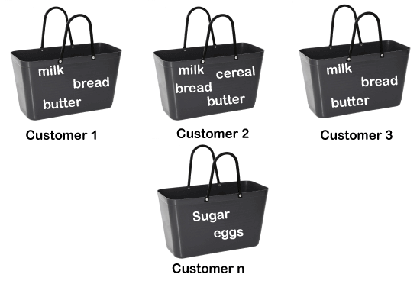
For example, if a customer buys bread, he most likely can also buy butter, eggs, or milk, so these products are stored within a shelf or mostly nearby.

Slide 74
Market Basket Analysis:
Market Basket Analysis is a technique used in data mining to discover relationships between items bought together in a transaction.
It answers questions like:
“If a customer buys bread, what is the probability they also buy butter?”
🎯 Real-Life Use Case
Imagine you're a supermarket manager. You want to know:
What items are commonly bought together?
How to place items on shelves?
Which products to recommend during checkout?
MBA helps you find these patterns using customer transaction data.

Slide 75
Example Transactions:
Transaction ID | Items Purchased
T1 | Bread, Butter, Milk
T2 | Bread, Butter
T3 | Milk, Diaper, Beer, Eggs
T4 | Bread, Milk, Diaper, Beer
T5 | Bread, Milk, Diaper, Cola

Slide 76
What MBA Does
It finds association rules like:
Bread → Butter (If a customer buys bread, they also buy butter)
Diaper → Beer
These rules help in decision-making:
Product placement
Cross-selling
Recommendations

Slide 77
📶 Key Terms You Must Know
Term | Meaning
Itemset | A group of items bought together (e.g., {Milk, Bread})
Support | Frequency of the itemset in all transactions
Confidence | Likelihood that when a customer buys item A, they also buy item B
Lift | Strength of the rule compared to random chance

Slide 78
Example Rule Calculation
Rule: Diaper → Beer
Let’s say:
Diaper appears in 3 transactions
Diaper & Beer together in 2 transactions
Beer appears in 2 transactions
Calculations:
Support = 2/5 = 0.4
Confidence = 2/3 ≈ 0.67
Lift = Confidence / Support(Beer) = 0.67 / 0.4 ≈ 1.67
👉 This means: People who buy diapers are 1.67x more likely to buy beer than random.

Slide 79
How Is Market Basket Analysis Done?
Usually using the Apriori or FP-Growth algorithms.
Steps:
Collect transaction data (e.g., shopping cart logs)
Set thresholds for:
Minimum support
Minimum confidence
Generate frequent itemsets
Create association rules
Evaluate the rules using Lift

Slide 80
Applications of Market Basket Analysis
Industry | Use Case
Retail | Shelf placement, combo offers
E-commerce | Product recommendations ("Customers also bought...")
Restaurants | Meal bundling (burger + fries + drink)
Banking | Cross-selling (credit card with savings account)
Healthcare | Co-occurring diseases or medications

Slide 81
Apriori algorithm:
The Apriori algorithm is a classic data mining technique used to find frequent patterns, associations, or relationships among items in large datasets — especially in Market Basket Analysis.
💡 It answers questions like:
“If people buy bread, how likely are they to also buy butter?”
It is designed to discover frequent itemsets in transactional databases and derive association rules from these itemsets.
The algorithm is named "Apriori" because it uses the "prior" knowledge of frequent itemsets to efficiently generate candidate itemsets.

Slide 82
Algorithm:
It uses Frequent itemsets to generate association rules and it is designed to work on databases that contains transactions.
This algorithm uses the Breadth First Search (BFS) and Hash Tree to calculate the itemset association efficiently.
Step-1: Determine the Support of itemsets and select minimum support and Confidence.
Step-2: Take all the supports in the transaction with higher support value than minimum or selected support value.
Step-3: Find all the rules of these sub itemsets that have higher confidence value than the threshold or decreesing order of Lift

Slide 83
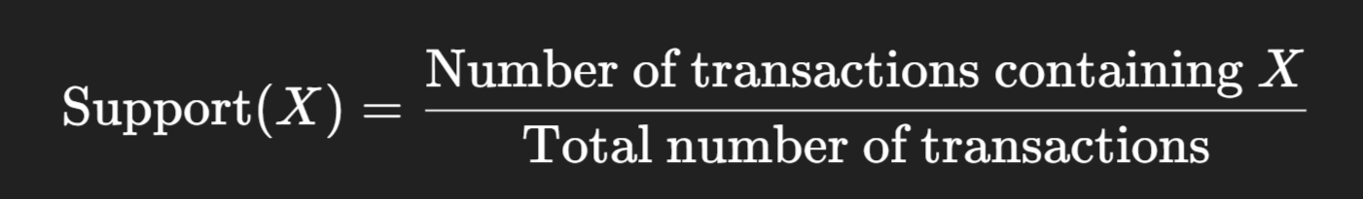
What is Support?
Support of an itemset is the proportion of transactions that contain that itemset.
It tells us how frequently an item or a group of items occurs in the dataset.
💡 Formula:

Slide 84
Example:
Let’s say we have 5 transactions:
Support of Bread = appears in T1, T2, T4, T5 = 4/5 = 0.8
TID | Items
T1 | Milk, Bread
T2 | Bread, Butter
T3 | Milk, Butter
T4 | Milk, Bread, Butter
T5 | Bread

Slide 85
Minimum Support:
We define a minimum support threshold (e.g., 0.5 or 50%) to ignore rare items.
🛠 Why?
We don’t want to generate rules from things that happen rarely (like once out of 1000 transactions).
Minimum Confidence:
We also set a minimum confidence (e.g., 0.6 or 60%) to filter out weak rules.

Slide 86
Example:
TId | Itemsets
T1 | A, B
T2 | B, D
T3 | B, C
T4 | A, B, D
T5 | A, C
T6 | B, C
T7 | A, C
T8 | A, B, C, E
T9 | A, B, C
A | Apple
B | Bread
C | Chicklet
D | Dry-Fruits
E | Egg
Given:
Min Support: 2 (Item should be present in min 2 transactions
Min Confidence: 50%
https://www.youtube.com/watch?v=F7f91QMAivY

Slide 87
Step-1: Find the Candidate Set C1 and Frequent Itemset L1
TId | Support Count
A | 6
B | 7
C | 5
D | 2
E | 1
TId | Support Count
A | 6
B | 7
C | 5
D | 2
C1
L1
All the itemsets have greater or equal then the Min support.
Candidate Set: Indicates how many time a particular item is present in the give transaction data set.
For example: the Candidate Set for A is nothing but how many times or in how many transaction the item A is present which is called as Support Count.
Frequent Itemset: All the itemsets which have greater or equal then the Min support.

Slide 88
Step-2: Candidate Generation C2 and L2
In this step we have to make a pair of the items in order and find the number occurences of those pairs in the given transaction.
Itemset | Support_count
[A,B] | 4
[A, C] | 4
[A, D] | 1
[B, C] | 4
[B, D] | 2
[C, D] | 0
TId | Support Count
[A,B] | 4
[A, C] | 4
[B, C] | 4
[B, D] | 2
L2
All the itemsets in C2 which have greater or equal then the Min support.
C2

Slide 89
Step-3: Candidate Generation C3 and L3
In this step we have to make a group of 3 items in order and find the number occurences of those pairs in the given transaction.
TId | Support Count
[A,B, C] | 2
[B, C, D] | 1
[A, C, D] | 0
[A, B, D] | 0
TId | Support Count
[A,B, C] | 2
L3
C3
Note: Now, we cannot create further combination as we have only one item.

Slide 90
Step-4: Finding the Associaton Rule for the Subset:
First we will calculate the Confidence using A->B = support( A ^ B) / support( A) Check the definition of Support.
After calculating we will exclude rules that have less confidence than the min threshold (50%).
TId | Itemsets | Confidence
A ^ B -> C | 2 | Sup((A^b)^C)/ Sup(A^B) = 2/4 = 50%
B ^ C -> A | 2 | Sup((B^C)^A)/Sup(B^C) = 2/4 = 50%
A ^ C -> B | 2 | = 50%
C -> A ^ B | 2 | = 40%
A -> B ^ C | 2 | = 33.33%
B-> B ^ C | 2 | 28%
Note: A ^ B -> C This means if a customer purchce a Product A and B then there is a high chance that he/she will purchace the product C as well.

Slide 91
Step-5: Conclusion.
According to the previous table eliminate those association rule which has the confidence level less than 50%.
So, we can conclude that the 1st Three Association Rules
A ^ B -> C
B ^ C -> A
A ^ C -> B
can be considered as the strong association rule for the given problem.

Slide 92
Evaluation metrics for association rules:
Evaluation metrics for association rules help determine the quality, usefulness, and interestingness of the rules discovered in association rule mining (like in the Apriori or FP-Growth algorithms). These metrics help decide which rules to keep and which ones to discard.

Slide 93
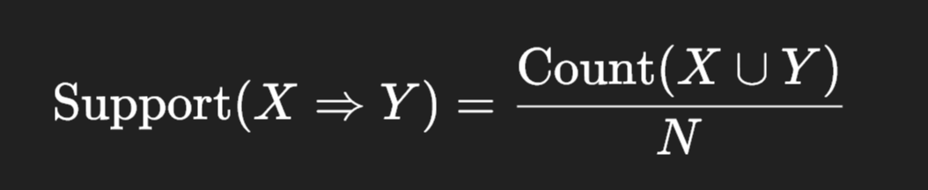
1. Support
Definition: Indicates how frequently the itemset appears in the dataset.
Formula:
Where X∪Y is the union of both itemsets, and N is the total number of transactions.
Purpose: Filters out infrequent rules.
Example: If 2 out of 10 transactions contain both bread and butter, support = 2/10 = 0.2

Slide 94
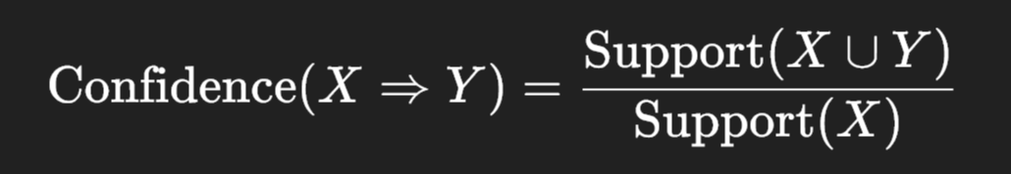
2. Confidence
Definition: Measures how often items in Y appear in transactions that contain X.
Formula:
Purpose: Measures the predictive power of the rule.
Example: If 4 out of 5 transactions that contain bread also contain butter, confidence = 4/5 = 0.8

Slide 95
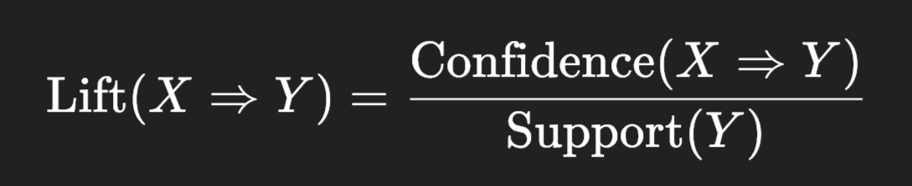
3. Lift
Definition: Measures how much more likely Y is to be bought when X is bought, compared to the baseline probability of buying Y.
Formula:
Interpretation:
Lift = 1 → X and Y are independent
Lift > 1 → Positive association
Lift < 1 → Negative association
Example: A lift of 1.5 means buying X makes buying Y 1.5 times more likely.

Slide 96
4. Leverage
Definition: Measures the difference between the observed frequency of X and Y appearing together and what would be expected if X and Y were independent.
Formula:
Interpretation:
Value close to 0 means independence
Higher value means stronger correlation

Slide 97
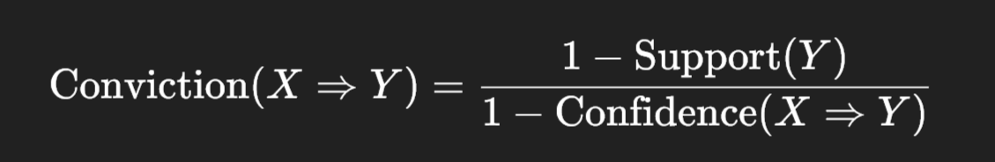
5. Conviction
Definition: Measures how frequently X occurs without Y, assuming X → Y is a rule.
Formula:
Interpretation:
Conviction > 1 suggests a stronger rule.
Higher conviction means fewer contradictions.

Slide 98
Module-3: Unsupervised Learning:
Clustering: K-Means clustering, Hierarchical clustering, Evaluation of clustering results.
Dimensionality Reduction: Principal Component Analysis (PCA), Linear Discriminant Analysis (LDA), t-Distributed Stochastic Neighbor Embedding (t-SNE).
Association Rule Learning: Apriori algorithm, Market Basket Analysis, Evaluation metrics for association rules

